Slide 1

Customer Discovery
WEEK TEN
CEO: Rachel Evans
CTO: Sophie Tanker
CFO: Andra Buchan

Slide 2
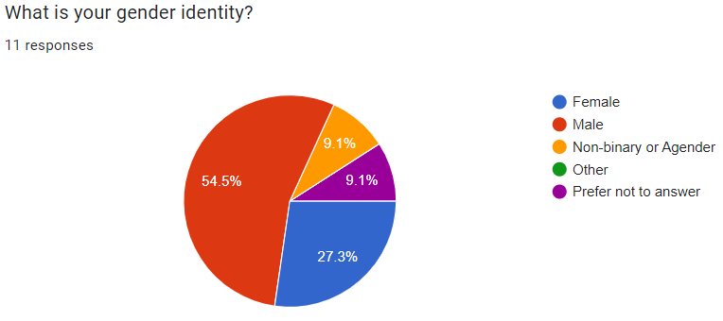
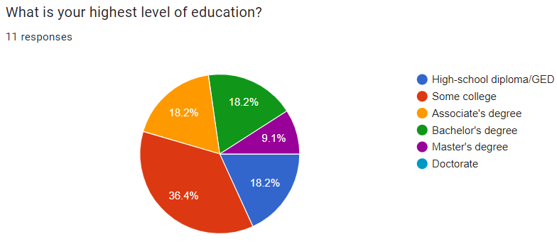
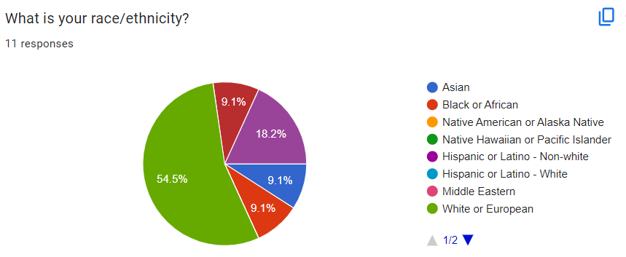
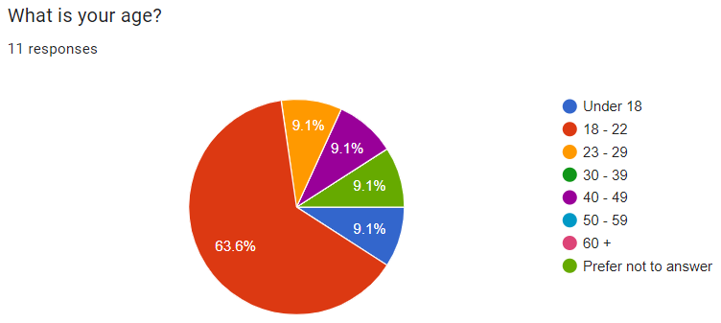
DEMOGRAPHIC INFORMATION

Slide 3
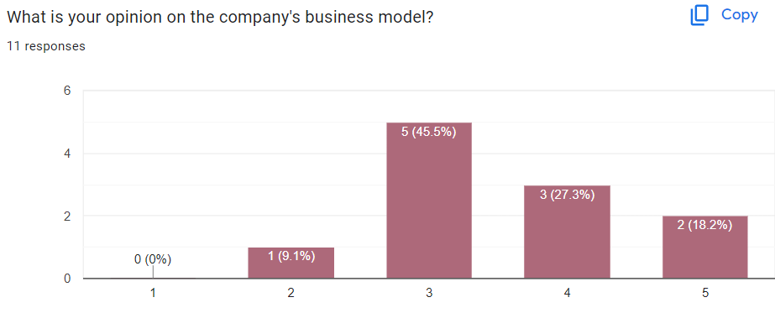
Do you like the company?

Slide 4
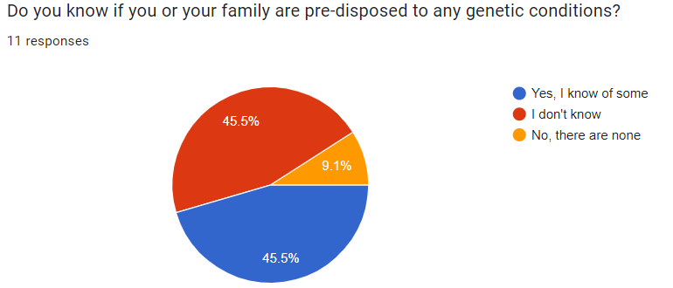
Are you predisposed to any conditions?

Slide 5
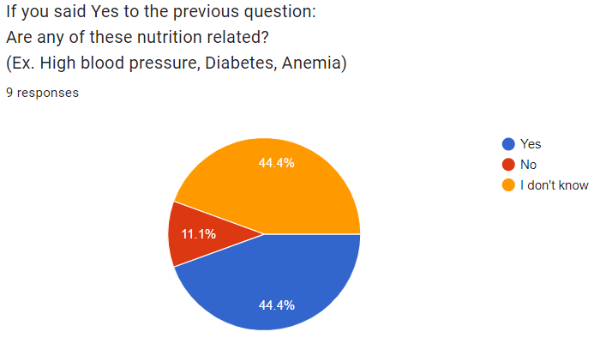
Are they nutrition related?

Slide 6
Polling with our Customer Archetypes in mind:
Asked respondents if they identified as an:
Athlete
Individual with a full-time job
Individual with 1+ known vitamin deficiencies
Pregnant/nursing
None of the above

Slide 7
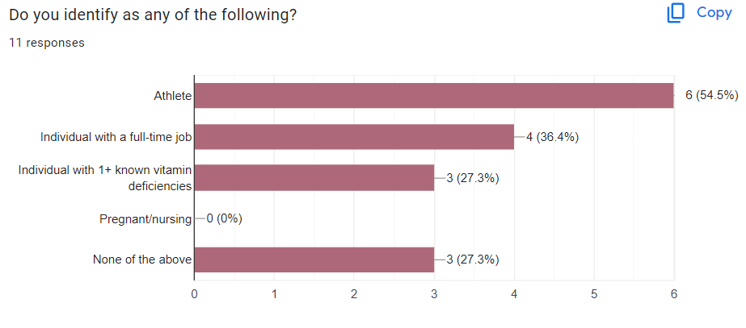
Do you identify as any of the following?

Slide 8
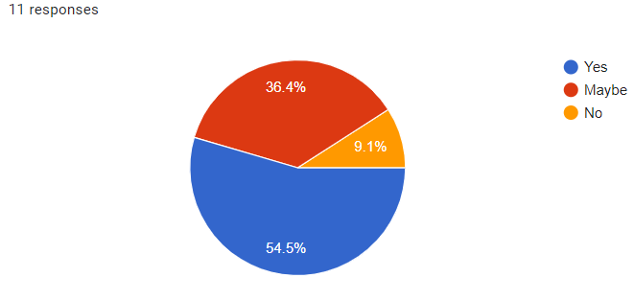
Most people, especially the aforementioned groups, need vitamins to stay healthy and productive. With this in mind, would you consider using a supplement subscription service that delivers supplements straight to your door monthly?

Slide 9

Target demographics:
Women
Those with known vitamin deficiencies

Slide 10
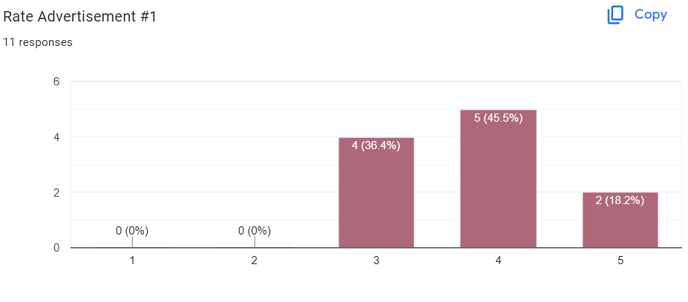
Sum of Ad #1 Ratings: 42
Average of Ad #1 Ratings: 3.82

Slide 11
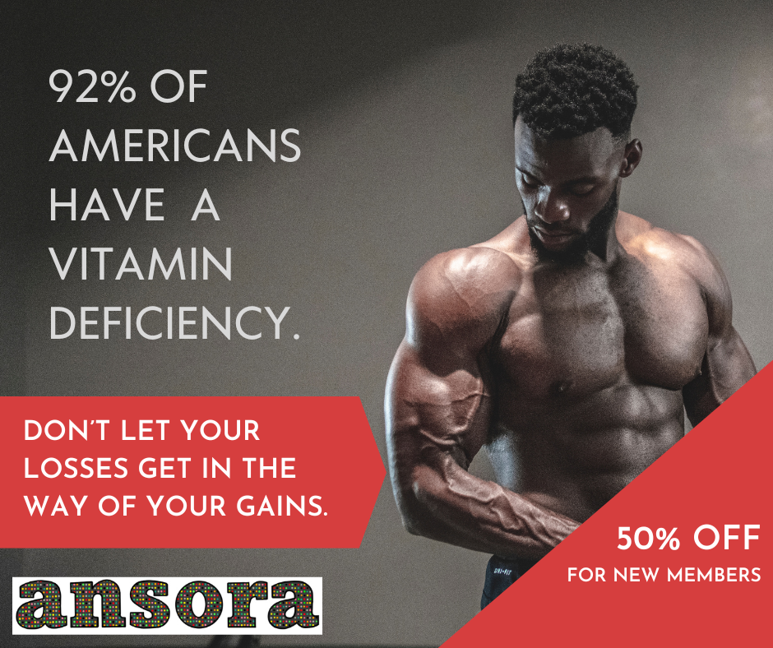
Target demographics:
Athletes
Those with known vitamin deficiencies

Slide 12
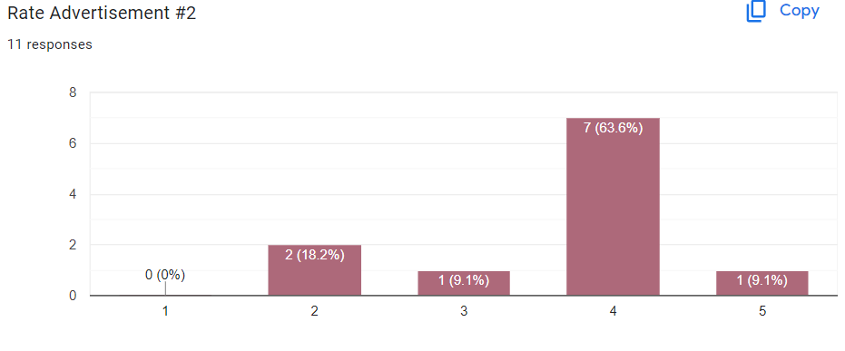
Sum of Ad #2 Ratings: 40
Average of Ad #2 Ratings: 3.64

Slide 13
COMMENTS
second one would look better with a transparent logo, not white background
Very good looking models.
You need someone more normal looking in the ad, so normal people think to use it.

Slide 14
TAKEAWAYS
Buff man ad polled way better than we expected
People think that the models are too attractive (??)

Slide 15
Thank you!

